Slide 1

HTML5
Graphics in HTML5
Narasimha

Slide 2

HTML5

Slide 3
what is Canvas?
HTML5
Used to draw different types of shapes like lines, rectangles, circles etc..
Provides options to filling shapes with single/multiple colors.
It supports gradients in order to fill multiple colors inside the shapes and texts.

Slide 4
<canvas> - Implementation
HTML5
Create canvas tag with id.
Get reference of canvas tag.
Create Graphics context with Canvas object
Draw the shapes with Graphics context object.

Slide 5
<canvas> - Implementation
HTML5
1
<canvas id="canvas1“></canvas>
2
var c1 = document.getElementById("canvas1");
3
var ctx = c1.getContext("2d");
4
ctx.lineTo();

Slide 6
HTML5
Drawing Graphics using Canvas

Slide 7
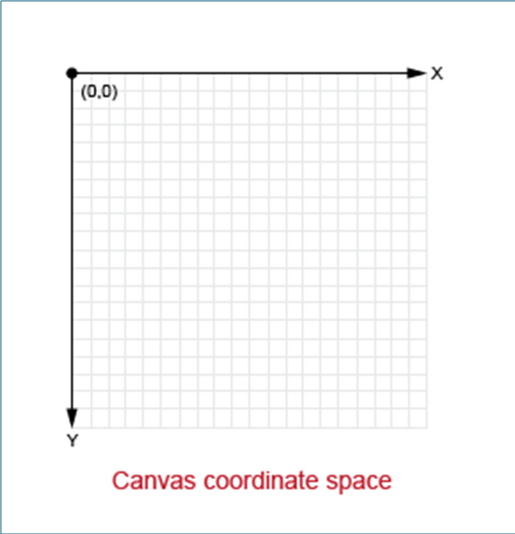
HTML5

Slide 8
HTML5
y
x
Height
Width

Slide 9
Drawing Lines
HTML5
ctx.moveTo(x,y);
ctx.lineTo(x,y);
ctx.stroke();

Slide 10
Drawing Lines with style
HTML5
ctx.moveTo(x,y);
ctx.lineTo(x,y);
ctx.strokeStyle = "Red";
ctx.stroke();

Slide 11
HTML5
Demo

Slide 12
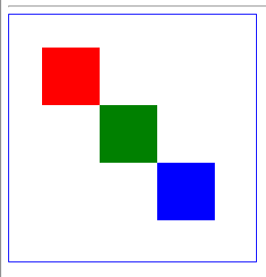
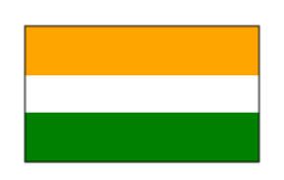
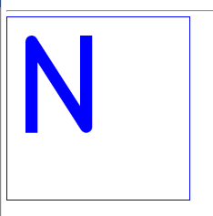
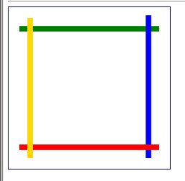
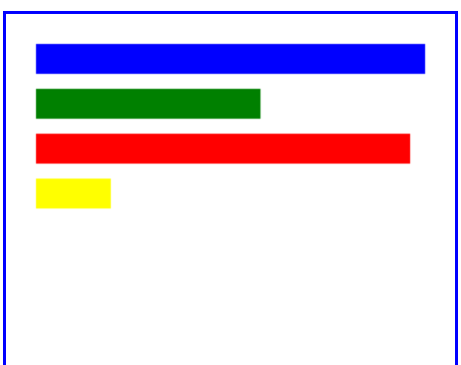
HTML5

Slide 13
Drawing Rectangles
HTML5
ctx.fillStyle = "Color";
ctx.fillRect(x,y,width,height);
ctx.strokeStyle = "Color";
ctx.strokeRect(x,y,w,h);

Slide 14
Drawing Text
HTML5
ctx.font="160px Calibri";
ctx.lineWidth = 2;
ctx.fillStyle = "Blue";
ctx.fillText(“Hello",0,200);

Slide 15
Drawing Circles
HTML5
ctx.fillStyle = "Red";
ctx.arc(90,80, 60, 0, 2 * Math.PI);
ctx.fill();
ctx.stroke();

Slide 16
HTML5
Demo

Slide 17
Drawing Texts
<canvas> tag
HTML5
ctx.font="size fontname";
ctx.fillStyle = "colorname";
ctx.fillText("text",x,y);

Slide 18
HTML5
Demo

Slide 19
Drawing Texts
<canvas> tag
HTML5
ctx.lineWidth = 5px;
ctx.strokeStyle = "blue";
ctx.strokeText(“text“,x,y);

Slide 20
HTML5
Demo

Slide 21
Drawing Rectangle – Linear Gradient
<canvas> tag
HTML5
var grd = ctx.createLinearGradient(x1,y1,x2,y2);
grd.addColorStop(offset, “color");
grd.addColorStop(offset, “color");
ctx.fillStyle = grd;
ctx.fillRect(x,y,width,height);

Slide 22
HTML5
Demo

Slide 23
Drawing Images
<canvas> tag
HTML5
var img = document.getElementById(“img1");
ctx.drawImage(img,10,10);

Slide 25
datalist
HTML5
<datalist id=“courses">
<option value="Internet Explorer">
<option value="Firefox">
<option value="Chrome">
<option value="Opera">
<option value="Safari">
</datalist>
</form>

Slide 26
HTML5
HTML5 Events

Slide 27
Event Attributes - Body Tag
HTML5
onafterprint
onbeforeprint
onbeforeunload
onpageshow
onresize

Slide 28
Multimedia Tags – HTML5
HTML5
Video
Audio

Slide 29
Multimedia Tags – HTML5
HTML5
<video id=“video1“>
<source src=“Test.mp4" type="video/mp4">
Your browser does not support HTML5 video.
</video>

Slide 30
<canvas> tag
HTML5
Attributes
height
width
style
<canvas id="myCanvas1"
width="200"
height="100"
style="border: 3px solid green;">
</canvas>

Slide 31
<canvas> tag
HTML5
Attributes
height
width
style
<canvas id="myCanvas1"
width="200"
height="100"
style="border: 3px solid green;">
</canvas>

